Slide 1
Abstract Data Structures
TOPIC 5.0 – ABSTRACT DATA STRUCTURES
TOPIC 5
5.1.18 – 5.1.20: Applications of Abstract Data Structures

Slide 2

REVIEW REVIEW REVIEW REVIEW REVIEW REVIEW
THE WARM-UP QUESTION
Take the values given here and create a binary search tree, assuming the values are added in order they are listed
15, 3, 14, 9, 8, 16, 1, 2

Slide 3
REVIEW REVIEW REVIEW REVIEW REVIEW REVIEW
THE WARM-UP ANSWER
15
3
16
1
14
2
9
8

Slide 4
Topic 5.1.18 – Dynamic data structures
Dynamic data structures
Dynamic data structures can change their size on the fly
Think of a Python list or a Pseudocode collection
Memory is automatically allocated (reserved, taken) and de-allocated
The memory is controlled by the data structure

Slide 5
Topic 5.1.19 – Dynamic data structures
Dynamic data structures Advantages
Makes efficient use of RAM, as only the memory needed is used
Easier when you don’t know the size of data as it can be dynamically allocated

Slide 6
Topic 5.1.19 – Dynamic data structures
DDS Disadvantages
Possibility that data will overflow out of the structure
Typically slower algorithms with dynamic data structures
Random access (by index) isn’t possible, elements have to be accessed in sequence
No way to implement binary search outside of tree
More complex to program as software keeps track of data locations
Generally, they are slower, but more robust

Slide 7
Topic 5.1.19 – Dynamic data structures
STATIC DATA STRUCTURES advantages
Memory allocation is fixed, leading to problems when adding/removing data
Easier to program (no checks on data structure size)
Space reserved in RAM will ALWAYS be available for the data structure

Slide 8
Topic 5.1.19 – Dynamic data structures
SDS DISadvantages
Can be very inefficient as the memory is predefined and not always used
Still takes up space even with no elements in it
May be difficult to pre-allocate the correct amount of space
Adding new items to a full one requires deletion of an older element
Or creation of an entire new SDS

Slide 9
Topic 5.1.19 – Dynamic data structures
Speed comparison
Array:
Access: O(1)
Search: O(n)
Insertion: O(n)
Binary Search Tree
Access (average case): O(logn)
Search (average case): O(logn)
Insertion (average case): O(logn)
Linked List
Access: O(n)
Search: O(n)
Insertion: O(1)

Slide 10
Topic 5.1.20 – ADT Suitability
Suitable structures
ADTs are conceptual, and many data structures can be used to ‘implement’ ADTs.
A linked list can be implemented using an array, and an array-type structure can be implemented using a linked list
Stacks and Queues can be implemented using either lists or arrays
It only matters that stacks have .pop and .push and queues have .enqueue and .dequeue

Slide 11
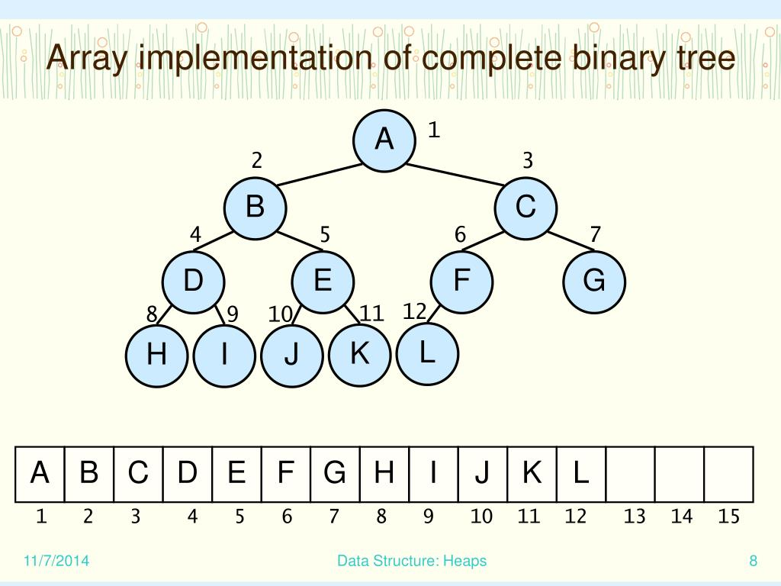
Topic 5.1.20 – ADT Suitability
Suitable structures
Trees can be represented using arrays
Should you do this? Probably not
Think of the complexity involved in deleting nodes. Do the spaces in the array stay empty?
If you delete a parent node, you have to move a node to its place, potentially moving multiple

Slide 12
Topic 5.1.20 – ADT Suitability
ADT Comparison
ADT | Benefits | Drawbacks
Array | Fast Insertion, Fast Access (with index) | Slow search, slow deletion, fixed size
Ordered Array | More efficient search than unordered | Slow search, slow deletion, fixed size
Stack | Models physical stacks, LIFO | Slow access to other elements
Queue | Models physical queues, FIFO | Slow access to other elements
Linked List | Fast Insertion, Fast Deletion | Slow Search
Binary Search Tree | Fast Search, Fast Insertion, Fast Deletion | Most complex

Slide 13

Topic 5.1 – THINKING RECURSIVELY
VOCAB TO REMEMBER
Abstract Data Structure
Trees
List
Static Data Structures
Dynamic Data Structures

